Slide 1
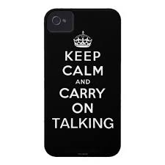
Pronunciation Workshop
Course Code: EPR005A
Joanna.Duchesne@morleycollege.ac.uk
8 January – 2 April 2014
The creation of this material by Morley College has been financed by the Skills Funding Agency Equality and Diversity Innovation Fund 2013/14.Copyright in this material is vested in the Crown but it is made freely available through an Open Government Licence. This licence enables you to use and adapt the material but you must attribute Morley College as the creator and include details of the licence. Full details of the licence are available at http://www.nationalarchives.gov.uk/doc/open-government-licence/

Slide 2
By the end of this session we will have:
Gone over the homework
Listened to presentations
Looked at /ei/ and /au/
Practised expressing opinions about same sex weddings

Slide 3
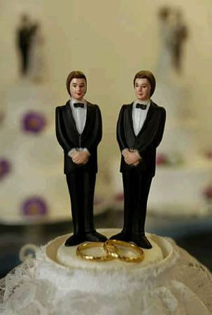
Same-sex marriage
Respect each other’s views
Listen
Express your opinion

Slide 4
/eɪ/
gay
discrimination
legislation

Slide 5
/aʊ/
out
proud
Loud
outrageous

Slide 6
out and proud
Where do the words link?
Which sound disappears?

Slide 7
LGBT /ɪː/
Wedding /ɪ/

Slide 8
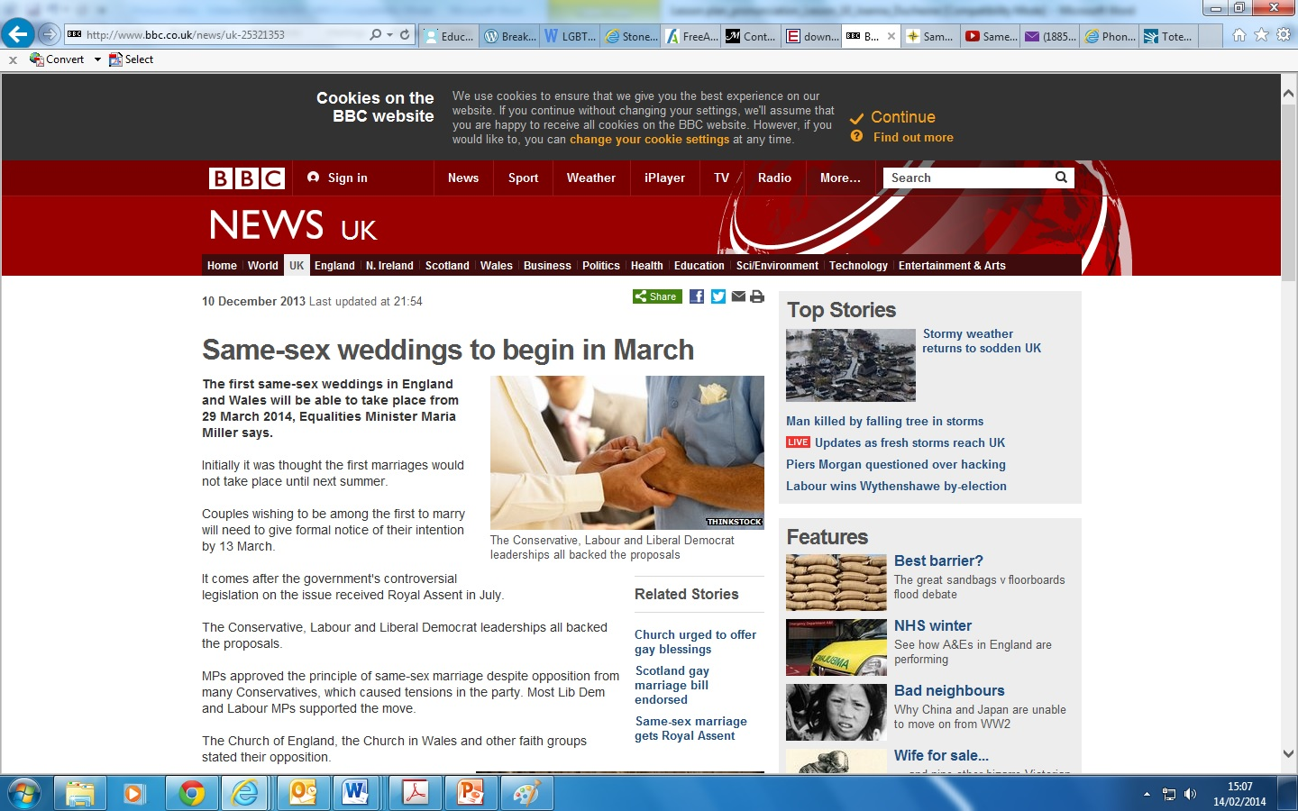

Slide 9
Lynne Featherstone
http://www.bbc.co.uk/news/uk-25321353
http://www.youtube.com/watch?v=QUibQuMZdBU

Slide 10
Are you surprised this is a new law in the UK?
What is the situation in your country?
Do you think same-sex weddings should be allowed? Why? Why not?

Slide 11
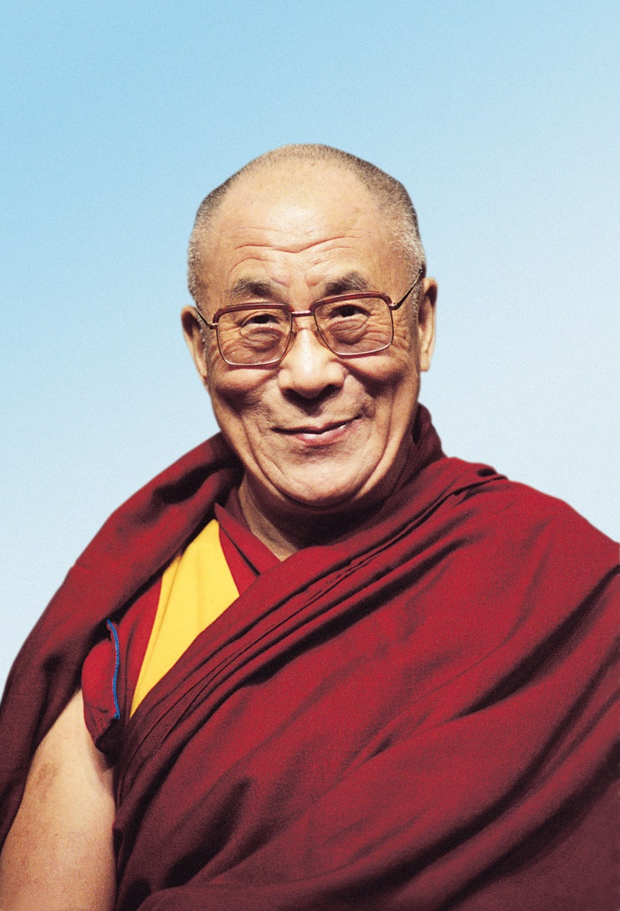

Slide 12
The Dalai Llama
http://www.youtube.com/watch?v=pJVvVSr8E2M
France protests
http://www.youtube.com/watch?v=l2b6EB3WjJU

Slide 13
Expressing opinion/discussing
I think that
I feel that
My opinion is the same
What do you think?
I don’t agree with you
I agree entirely
I understand your point of view but

Slide 14
You are going to take part in a TV debate.
Your teacher will give you a role. Prepare your opinions about same-sex weddings, which will be allowed from 29 March.
What do you think about this? Why?

